Slide 1
Warm UP
What is an externality? Give an example of a positive externality. A negative one.
What is perfect competition? What characteristics are necessary for perfect competition. Give an example
What is collusion? Price Fixing? Why are they illegal?
What is Laissez-Faire Economics? What Physiocrat came up with this concept? What book did he write? What type of economics is this?
CEQ: What were the results of Super Tuesday? Which candidate’s campaigns are in trouble after last night’s results?

Slide 2
Chapter 12

Slide 3
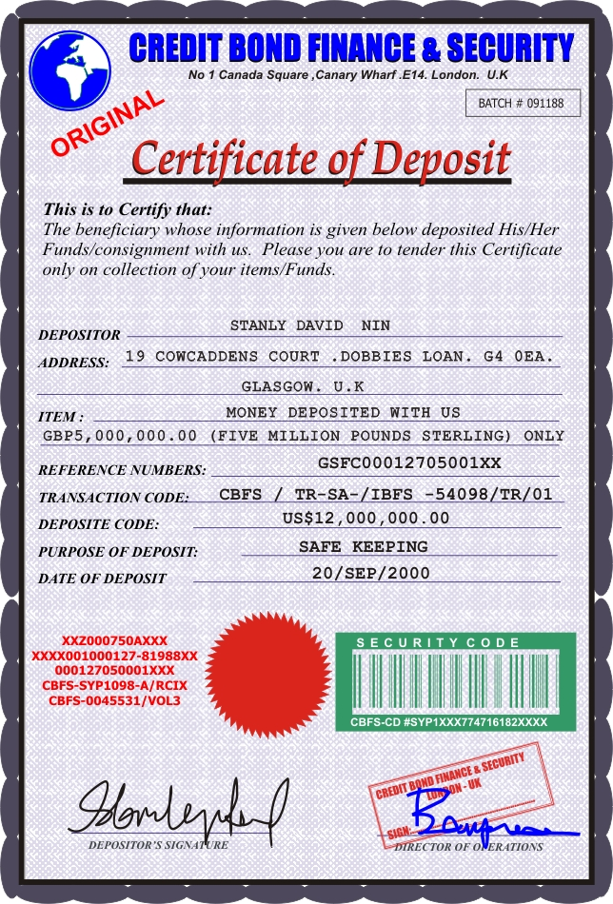
Chapter 12
Savings – refers to the dollars that become available when people abstain from consumption
Financial System – a network of savers, investors, and financial institutions that work together to transfer savings to investors
Certificate of Deposit – A receipt showing that an investor has made an interest-bearing loan to a bank

Slide 4
Chapter 12
Financial Assets – Claims on the property and the income of the borrower
Financial Intermediaries – Financial institutions that lend the funds that savers provide to borrowers
Depository institutions
Life Insurance Companies
Pension Funds, etc.
Overview of the Financial System – Pg. 315

Slide 5
Warm Up
What is a certificate of deposit?
What are financial assets?
What is a premium?
What is a financial system?
What are three examples of financial intermediaries?
What stock did you purchase and how many shares? What was the price you purchased it for?
CEQ: What Presidential campaign had the best performance on Tuesday? The worst?

Slide 6
Warm Up
How much is your stock trading for at this very moment? How much profit/loss is this compared to your original purchase price? What percentage change is this compared to your original purchase price?
CEQ: How much economic growth did the United States experience in the last two quarters (July-Sept 2015 and Oct-Dec 2015)? Is this good or bad for our short term economic goals?
CEQ: Does “Daylight Savings Time” serve its original purpose? Why was it originally proposed? How many time zones does China have?

Slide 7
Chapter 12
Nonbank Financial Institutions – Non-depository institutions that channel savings to borrowers.
Finance companies
Life insurance companies
Pension funds
Real estate investment
Finance Company – A firm that specializes in making loans directly to consumers and in buying installment contracts from merchants who sell goods on credit
Bill Consolidation Loans – A loan that consumers use to pay off other bills

Slide 8
Chapter 12
Premium – the price the insured pays for this policy and is usually paid monthly, quarterly or annually for the length of the protection
Mutual Fund – A company that sells stock in itself to individual investors and then invests the money
Net Asset Value (NAV) – the net value of the mutual fund divided by the number of shares issued by the mutual fund

Slide 9
Chapter 12
Pension – A regular payment intended to provide income security to someone who has worked a certain number of years, reached a certain age, or suffered a certain kind of injury
Pension Fund – a fund set up to collect income and disburse payments to those persons eligible for retirement, old-age, or disability benefits

Slide 10
Chapter 12
Real estate investment trust (REIT) – A company organized primarily to make loans to construction companies that build homes
Risk – A situation in which the outcome is not certain, but probabilities for each possible outcome can be estimated
Relationship between risk and return – Pg. 319

Slide 11
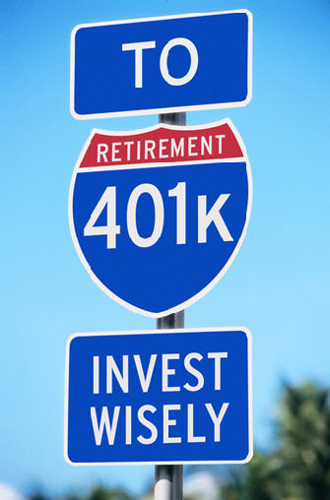
Chapter 12
401(k) Plans – A tax deferred investment and savings plan that acts as a personal pension fund for employees
Coupon – the stated interest on the debt
Maturity – the life of the bond
Par Value – the principal or the total amount initially borrowed that must be repaid to the lender at maturity

Slide 12
Chapter 12
Current Yield – the annual interest divided by the purchase price.
Ex) If an investor paid $950 for a bond at 6.32% then the current yield would be $60
Municipal Bonds – bonds issued by state and local governments
Tax-Exempt – The federal government does not tax the interest paid to investors
Savings Bonds – Low-denomination, nontransferable bonds issued by the United States government
Treasury Notes – United States government obligations with maturities of two to ten years
Treasury Bonds – Have maturities ranging from 10 to 30 years

Slide 13
Warm UP
Make sure your stock market project is up to date!
Who owns a corporation?
What is the primary goal of a corporation?
What allows corporations to raise more money? Sale from stock or sale of bonds?
What are “diminishing marginal returns”?
What are the five characteristics of Perfect Competition?
What is a natural monopoly? Government monopolies?
What is the purpose of anti-trust laws?
What does volume mean in regards to the Stock Market?
CEQ: What were the election results last night?
CEQ: Who did Obama just nominate to fill the vacant Supreme Court seat?
Notes:
Angus Deaton

Slide 14
Chapter 12
Treasury Bills (T-Bill) – a short-term obligation with a maturity of 13,26 or 52 weeks and a minimum denomination of $1000
Individual Retirement Accounts (IRAs) – Long-term, tax sheltered time deposits that an employee can set up as part of a retirement plan
Roth IRA – An IRA whose contributions are made after taxes so that no taxes are taken out at maturity

Slide 15
Chapter 12
Capital Market – A market where money is loaned for more than one year
Money Market – A market where money is loaned for periods of less than one year
Primary Market – A market where only the original issuer can repurchase or redeem a financial asset
Secondary Market – A market in which existing financial assets can be resold to new owners

Slide 16
Chapter 12
Equities – Stocks that represent ownership shares in corporations
Efficient Market Hypothesis (EMH) – The argument that stocks are always priced at about the right level
Portfolio Diversification – The practice of holding a large number of different stocks so that increases in some can offset unexpected declines in others
Stockbroker – a person who buys or sells equities for clients
Securities Exchanges – Places where buyers and sellers meet to trade securities

Slide 17
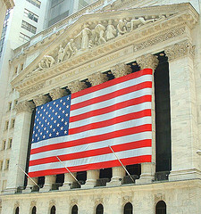
Chapter 12
Over-the-Counter Market (OTC) – electronic marketplace for securities that are not traded on an organized exchange
Standard & Poor’s 500 – uses the price changes of 500 representative stocks as an indicator of overall market performance
Spot Market – A market in which a transaction is made immediately at the prevailing price

Slide 18
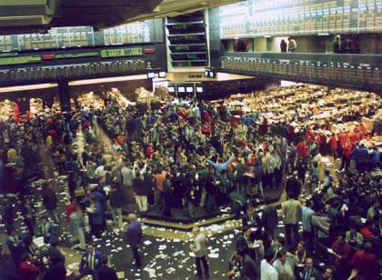
Chapter 12
Futures contract – an agreement to buy or sell at a specific date in the future at a predetermined price
Futures Markets – the marketplaces in which futures contracts, or “futures”, are bought and sold
Options – contracts that provide the right to purchase or sell commodities or financial assets at some point in the future at a price agreed upon today

Slide 19
Chapter 12
Call Option – The right to buy a share of stock at a specified price some time in the future
Put Option – the right to sell a share of stock at a specified price in the future
Option Markets – Markets in which options are traded

Slide 20
All Content Created by DJ Cook

